Slide 1



Workshop Jurusan Statistika
Universitas Negeri Padang
8 – 9 Oktober 2019
EKSPLORASI DATA
dan
pemodelan prediktif
Bagus Sartono
Departemen Statistika
Fakultas Matematika dan Ilmu Pengetahuan Alam

Slide 2
Outline
Pembelajaran Statistika
Perkenalan
Pemodelan Prediktif
Perlu Eksplorasi?
Hands-On Session
katanya... tak kenal maka tak sayang…
Gambaran umum tentang pemodelan prediktif dan tahapan-tahapannya.
Diskusi mengenai pentingnya eksplorasi dalam pemodelan prediktif
Sesi praktek penyelesaian kasus
sekaligus sesi penutup
slide tersedia di http://github.com/bagusco/UNP
Notes:
© Copyright Showeet.com – Free PowerPoint Templates

Slide 3
Siapa Saya?

Slide 4

Bagus Sartono
Riwayat Pendidikan
Sarjana Sains, Statistika – Institut Pertanian Bogor, 2000
Magister Sains, Statistika – Institut Pertanian Bogor, 2004
Doctor of Philosophy, Applied Economics – Unversiteit Antwerpen, 2012
Pengalaman Kerja sebagai Dosen di IPB
2000 – sekarang, Departemen Statistika
S1, Aljabar Matriks
S1, Analisis Eksplorasi Data
S2, Pemodelan Klasifikasi
S2, Metode Grafik untuk Analisis dan Penyajian Data
S3, Analisis Data Lanjut
2013 – 2015, PS Primatologi
S3, Metodologi Penelitian Satwa Primata
2013 – sekarang, Sekolah Bisnis
2016 – sekarang, PS MITNR
S2, Geostatistics

Slide 5
Bagus Sartono
Pengalaman Konsultansi
2002 – 2008, Statistician – PT Ganesha Cipta Informatika
2008 – 2012 …. melanjutkan studi….
2013, Technical Advisor – MarkPlus Insight
2013, Consultant – CIFOR
2014, Project Leader – PT Trans Intra Asia
2015 – 2017, Data Science Advisor – Starcore Analytics
2018, Consultant – IACCB
Pengalaman Lainnya
Trainer bidang Statistika, Data Mining, Analitika di berbagai instansi, antara lain Bank Mandiri, Bank Syariah Mandiri, Bank Sinar Mas, Bank Danamon, Bank Indonesia, OJK, Telkomsel, Bank Permata, CIMB Niaga, LIPI, Kementerian Pertanian, Kementerian Keuangan
Tenaga ahli di beberapa kegiatan kajian, antara lain Kementerian Pendidikan dan Kebudayaan, BPJS, Kementerian Keuangan, OJK, Bank Indonesia, LIPI, Astra Digital.

Slide 6
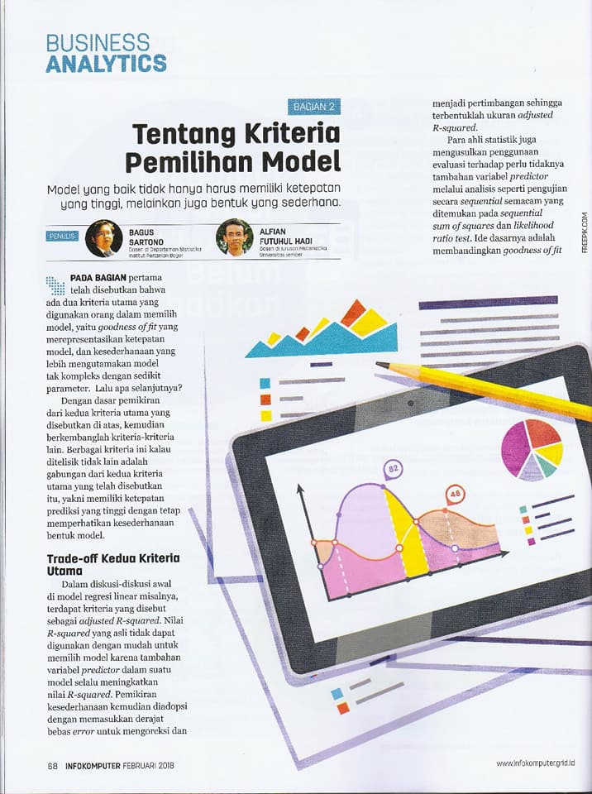

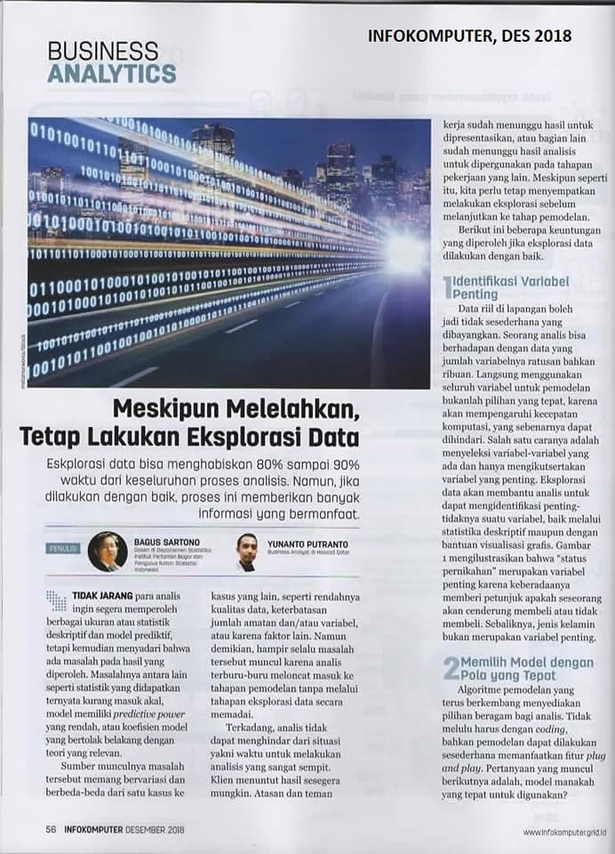
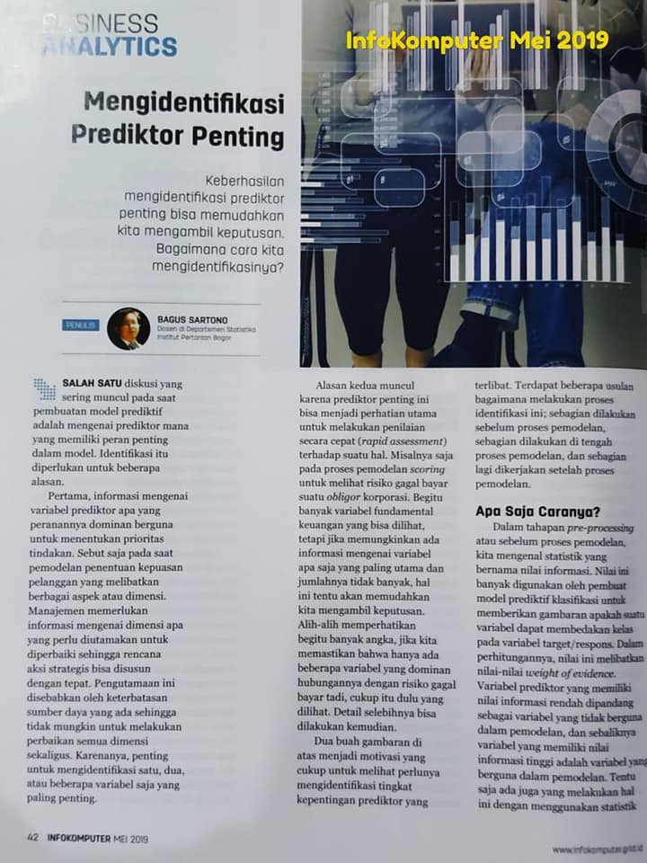
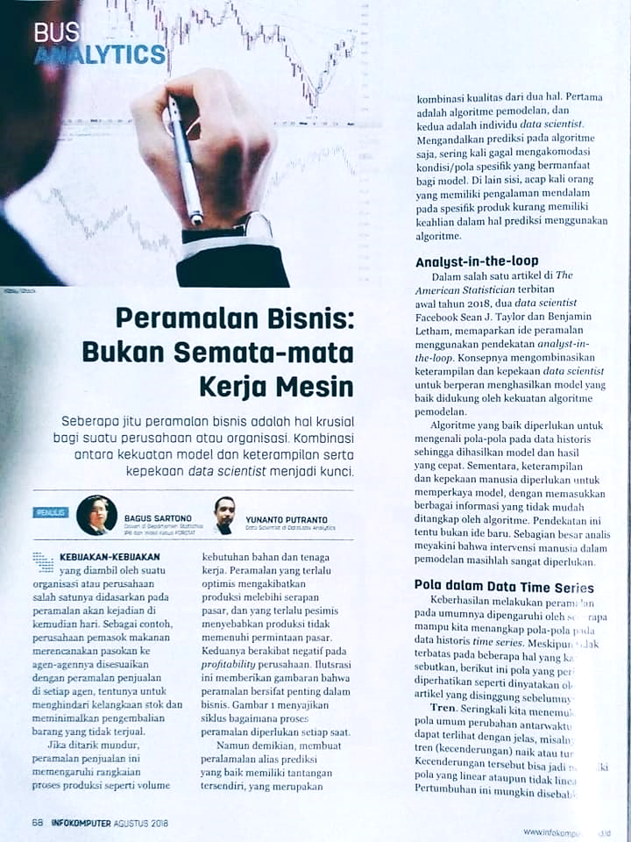
aktifitas lain: Penulis rubrik Business Analytics di Majalah InfoKomputer

Slide 7

Kompetensi Terkait Data
#1
Akuisisi Data (Data Acquisition)
#6
#2
Kontekstualisasi Hasil Analitik (Analytic Contextualizing)
Pengelolaan Data (Data Management)
#5
Komunikasi dan Visualisasi Data (Communication and Visualization)
#3
#4
Eksplorasi Data
(Data Exploratory)
Pemodelan Prediktif (Predictive Modeling)

Slide 8
Pemodelan Prediktif

Slide 9
Sama atau Berbeda?
Statistika
Data Mining
Analitika
Notes:
© Copyright Showeet.com – Free PowerPoint Templates

Slide 10
Model-Driven Activity
statistika
analitika
data mining
Purpose-Driven Activity
Data-Driven Activity

Slide 11
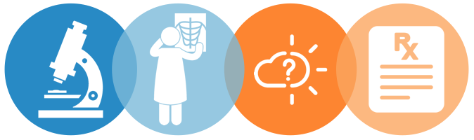
Types of Analytics
DESCRIPTIVE
Explains what happened
DIAGNOSTIC
Explains why it happened
PREDICTIVE
Forecasts what might happen
PRESCRIPTIVE
Recommends
an action

Slide 12

Kegunaan Analitika
Identifying past and current conditions
Proactivity and anticipating needs
Optimising and improving operational efficiency
Mitigating risk
Notes:
Inventarisasi, perencanaan, pelaksanaan, pengawasan

Slide 13
Predictive Analytics
Predictive analytics is the branch of advance analytics which is used to make prediction about unknown future events. (PAT Research)
Predictive analytics is the use of data, statistical algorithms and machine learning techniques to identify the likelihood of future outcomes based on historical data. (SAS)
Predictive analytics is a category of data analytics aimed at making predictions about future outcomes based on historical data and analytics techniques such as statistical modeling and machine learning. (John Edward, cio.com)

Slide 14

Predictive Analytics in Business
CREDIT scoring
Scoring model to predict the risk level of debtors
Classification model involving predictors: socio-demographical variables, historical payment, other transaction records
Scores
Good/Excellent Risk
Bad/Poor Risk
Common algorithms:
Logistic Regression
Classification Tree

Slide 15


Predictive Analytics in Business
Propensity model to predict the likelihood-to-buy of individuals
Up-Sell / Cross-Sell campaign
Selective campaign
High propensity → give the offering
Low propensity → no offer
Common algorithms: Random Forest, Boosted Tree

Slide 16

Predictive Analytics in Business
Debit/Credit Card
activation
Identifying the probability of dormant cards to be active
Recall Campaign to the prospective active card holder
Common Algorithm:
k-Nearest Neighbor

Slide 17
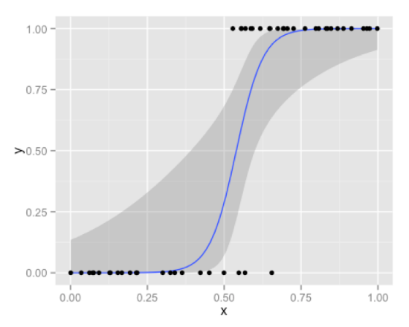
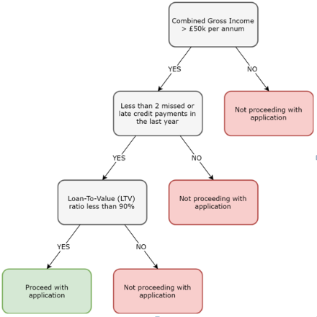
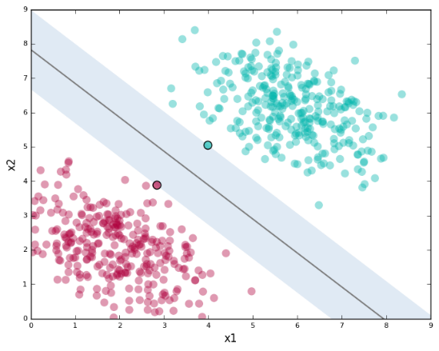
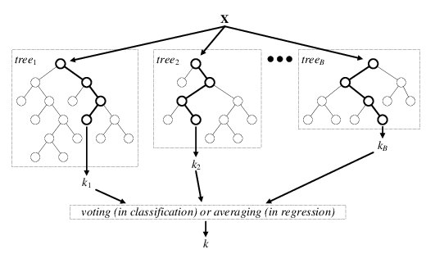

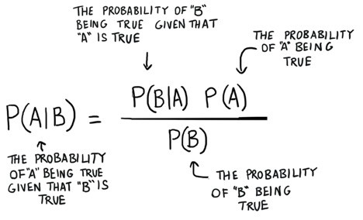
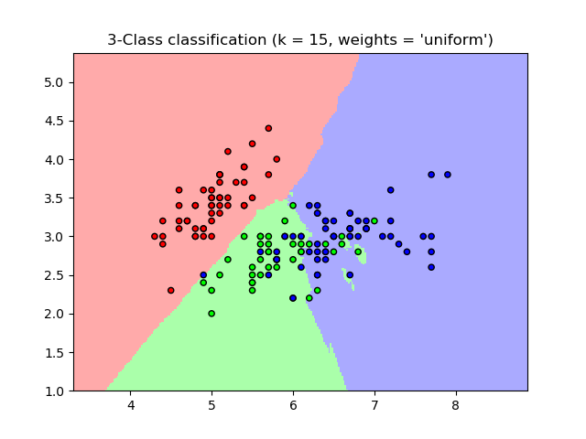
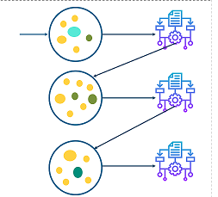
Common Classification Model Algorithms
Logistic Regression
Classification Tree
Support Vector Machine
Random Forest
Neural Network
Bayesian Classifier
k-Nearest Neighbor
Boosting

Slide 18
Perlu Eksplorasi?

Slide 19
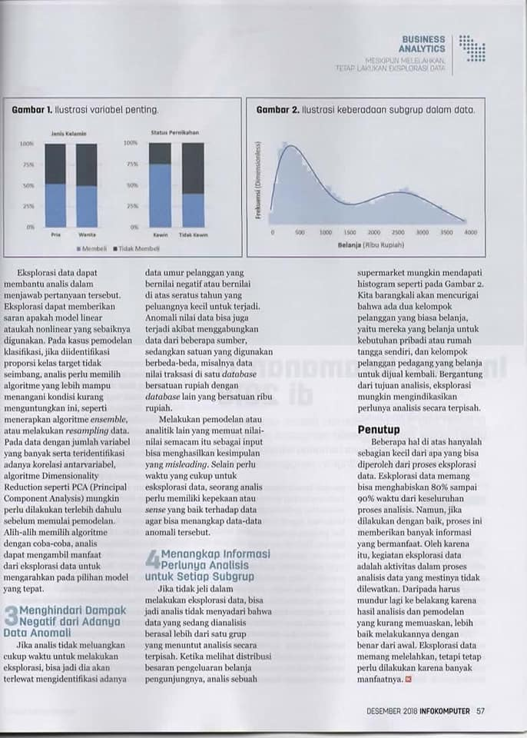

Slide 20
Catatan dari Pengalaman #1
Banyak praktisi yang melewatkan proses eksplorasi, dan cenderung loncat ke tahapan pemodelan atau analisis akhir lainnya

Slide 21
Cerita dari Kantor Kementerian
Ingin melihat efektifitas impor cabe terhadap pengendalian harga
Data dikumpulkan dari berbagai sumber, dari lintas instansi, dari berbagai tahun, dari banyak publikasi
Analisis yang digunakan: Regresi
Y: harga
X: volume impor
Hasil analisis: bingung… kok kebalik dari teori ya?

Slide 24
Catatan dari Pengalaman #2
Ada kemungkinan pola yang terhadap pada satu kelompok berbeda dengan kelompok lain.
Data yang memuat beberapa kelompok dapat membuat pola asli-nya tidak kelihatan.

Slide 25
Ilustrasi ^{*)}
Kab | IPM | APBD
Bandung | 69.1 | 2027.2
Bandung Barat | 64.3 | 948.2
Bekasi | 70.5 | 1508.0
Bogor | 67.4 | 2204.3
Ciamis | 67.6 | 999.7
Cianjur | 62.1 | 1342.9
Cirebon | 65.5 | 1266.4
Indramayu | 63.6 | 1018.8
Karawang | 67.1 | 1209.3
Kuningan | 66.6 | 1048.4
Majalengka | 64.1 | 1056.2
Pangandaran | 65.3 | 463.7
Purwakarta | 67.3 | 895.3
Subang | 65.8 | 999.5
Sukabumi | 64.1 | 1248.8
Sumedang | 68.8 | 977.1
Kota Bandung | 79.0 | 1117.5
Kota Banjar | 68.3 | 237.9
Kota Bekasi | 78.8 | 1243.2
Kota Bogor | 73.1 | 599.4
Kota Cimahi | 76.1 | 451.7
Kota Cirebon | 72.9 | 432.0
Kota Sukabumi | 71.2 | 324.5
CORR = -0.18
*) diadaptasi dari skripsi Tri Utami Maharani (2014) -- Analisis Hubungan Indeks Pembangunan Manusia dengan Anggaran Belanja Kabupaten dan Kota di Jawa Barat ﻿

Slide 26
terkesan ada hubungan negatif antara APBD Bidang Pendidikan dan IPM
CORR = -0.18

Slide 27
Lihat perbedaan tampilan kalau dibedakan antara Kota dan Kabupaten

Slide 28
Kesan hubungan negatif menjadi berkebalikan

Slide 29
Catatan dari Pengalaman #3
Kesuksesan proses analitika tidak hanya terletak pada kemampuan teknis dan pengetahuan metode canggih, namun juga pada kreativitas melihat masalah dan menghasilkan informasi penting untuk diubah menjadi aksi

Slide 30
Cerita dari Kebun Kelapa
Perusahaan perkebunan kepala ingin mengetahui faktor apa yang mempengaruhi kualitas buah kelapa hasil panennya
Yang dilakukan:
Analisis Regresi
Y1: banyaknya buah kelapa Grade A, Y2: banyaknya buah kelapa Grade B, Y3: banyaknya buah kelapa Grade C
X1: luas kebun yang dipanen, X2: volume pupuk yang digunakan, X3: total hari orang kerja (HOK),… dan beberapa peubah lainnya
Hasil analisis: membingungkan…
Semakin banyak pupuk, semakin banyak buah kelapa grade A
Semakin banyak pupuk, semakin banyak buah kelapa grade B
Semakin banyak pupuk, semakin banyak buah kelapa grade C

Slide 31
Cerita dari Telco-company
Kasus micro-segmentation… penawaran yang targeted akan cenderung semakin berhasil
Banyak variabel dikumpulkan dan diekstrak dari database (prinsip: semakin banyak data, semakin banyak informasi)
Analisis: k-means clustering + biplot
Hasil: 30+ cluster, bagaimana menginterpretasikannya?

Slide 32
Hands-On Session

Slide 33
Bahan Diskusi
Diskretisasi
WoE dan Information Value
Ensemble Tree

Slide 34
Diskretisasi
Bagus Sartono
Departemen Statistika
Fakultas Matematika dan Ilmu Pengetahuan Alam

Slide 35
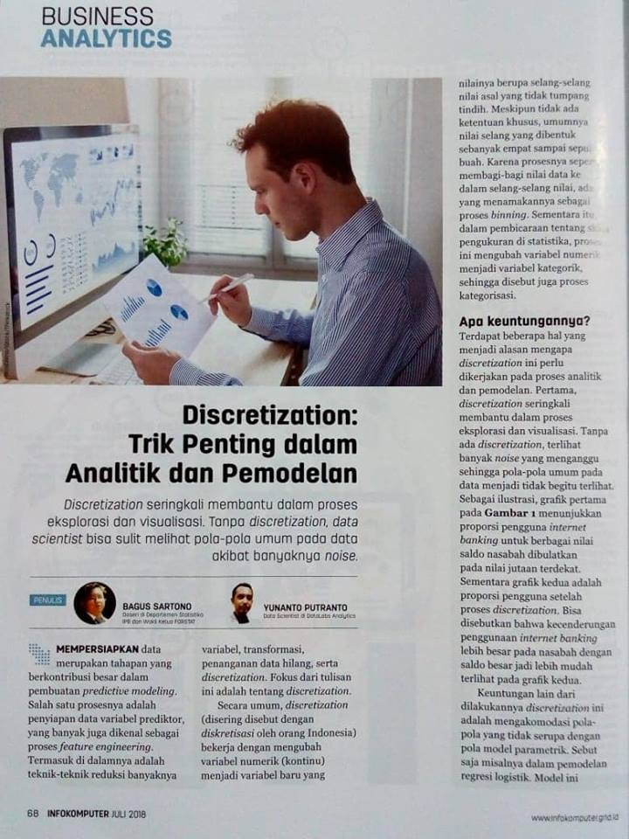
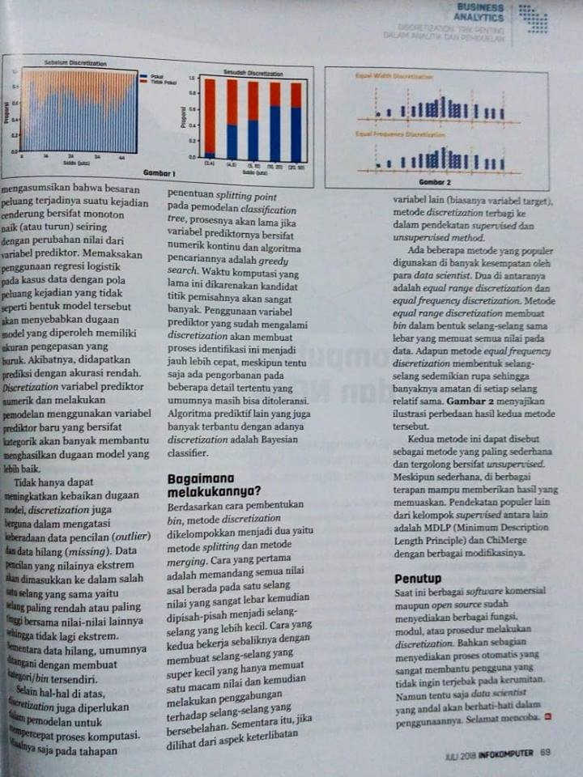

Slide 36
Outline
Pendahuluan dan Motivasi
Pengelompokan Metode Diskretisasi
Unsupervised Discretization
Supervised Discretization

Slide 37
Pendahuluan
Data terdiri atas banyak variabel dengan berbagai format/tipe:
Numerik diskret
Numerik kontinu
Kategorik ordinal
Kategorik nominal
Variabel yang bertipe numerik dapat diubah menjadi kategorik (ordinal) → prosesnya dikenal sebagai diskretisasi, ada juga yang menyebut sebagai binning
Diskretisasi ini sering membantu dalam pemodelan prediktif

Slide 38
Diskretisasi
Andaikan dataset berisi N observasi, proses diskretiasi terhadap variabel numerik A adalah mengubah nilai variabel tersebut menjadi m interval D = {[d₀, d₁], (d₁, d₂], …, (d_{m−1}, d_{m}]}, dengan d₀ adalah nilai terkecil, d_{m} adalah nilai terbesar, dan d_{i} < d_{i+i}, untuk i = 0, 1, ...,m−1.

Slide 39
Diskretisasi
6.58
15.35
14.24
6.22
1.82
2.11
13.77
5.65
15.58
12.46
13.05
11.64
10.91
14.31
7.42
X ≤ 5
5 < X ≤ 10
10 < X ≤ 15
X > 15

Slide 40
Motivasi
Without data discretization some rules would be difficult to establish.
Several existing data mining systems cannot handle continuous variables without discretization.
Data discretization significantly improves the quality of the discovered knowledge.
Data discretization significantly improves the performance of data mining algorithms. Some studies reported ten fold increase in performance. However:
Any discretization process generally leads to a loss of information. Minimizing such a possible loss is the mark of good discretization method.

Slide 41
Merging
Supervised
ChiMerge
Diskretisasi
Un-Supervised
Equal Width
Equal Freq
Splitting
Supervised
Tree/MDLP

Slide 42
Unsupervised Discretization

Slide 43
Equal Width dan Equal Frequency
In equal width, the continuous range of a feature is divided into intervals that have an equal width and each interval represents a bin. The arity can be calculated by the relationship between the chosen width for each interval and the total length of the attribute range.
In equal frequency, an equal number of continuous values are placed in each bin. Thus, the width of each interval is computed by dividing the length of the attribute range by the desired arity.

Slide 44
Unsupervised Discretization: Equal Width Discretization
Unsupervised Discretization: Equal Freq Discretization

Slide 45
x <- c(15, 4, 21, 11, 16, 18, 24, 26, 28)
library(classInt)
#equal width
eqwid <- classIntervals(x, 4, style = 'equal')
eqwid$brks
x.eqwid <- cut(x, breaks=eqwid$brks, include.lowest=TRUE)
cbind(x, x.eqwid)
> eqwid$brks
[1] 4 10 16 22 28
> cbind(x, x.eqwid)
x x.eqwid
[1,] 15 2
[2,] 4 1
[3,] 21 3
[4,] 11 2
[5,] 16 2
[6,] 18 3
[7,] 24 4
[8,] 26 4
[9,] 28 4

Slide 46
#equal freq
eqfreq <- classIntervals(x, 4, style = 'quantile')
eqfreq$brks
x.eqfreq <- cut(x, breaks=eqfreq$brks, include.lowest=TRUE)
cbind(x, x.eqwid, x.eqfreq)
> eqfreq$brks
[1] 4 15 18 24 28
> cbind(x, x.eqwid, x.eqfreq)
x x.eqwid x.eqfreq
[1,] 15 2 1
[2,] 4 1 1
[3,] 21 3 3
[4,] 11 2 1
[5,] 16 2 2
[6,] 18 3 2
[7,] 24 4 3
[8,] 26 4 4
[9,] 28 4 4

Slide 47
Ilustrasi efek diskretisasi terhadap kualitas model prediktif
Akan dipaparkan situasi dimana diskretisasi mampu memberikan peningkatan akurasi prediksi pada model regresi logistik
Akan dibandingkan akurasi dua model dengan data yang sama
Model pertama menggunakan variabel prediktor asli
Model kedua menggunakan variabel prediktor yang telah didiskretkan
Buka file program “UNP diskretisasi.R”

Slide 48
> table(data.ts$class, prediksi.asli)
prediksi.asli
0 1
0 93 134
1 94 137
> mean(data.ts$class == prediksi.asli)
[1] 0.5021834
> table(data.ts$class, prediksi.disk)
prediksi.disk
0 1
0 177 50
1 73 158
> mean(data.ts$class == prediksi.disk)
[1] 0.731441

Slide 49
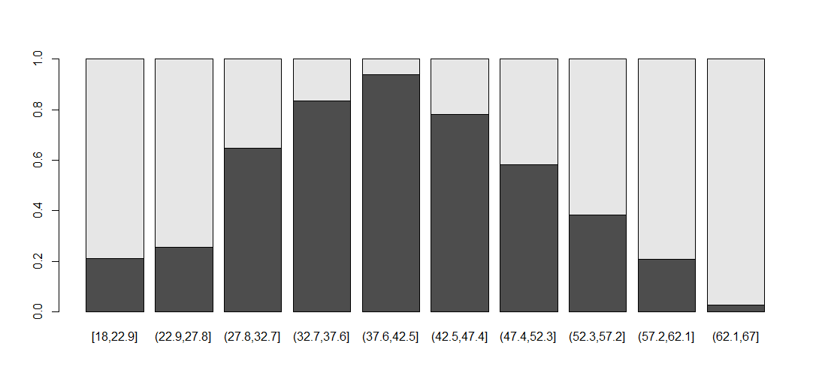
proporsi <- prop.table(table(data.tr$x.disk, data.tr$class), margin=1)
barplot(t(proporsi))

Slide 50
Supervised Discretization

Slide 51
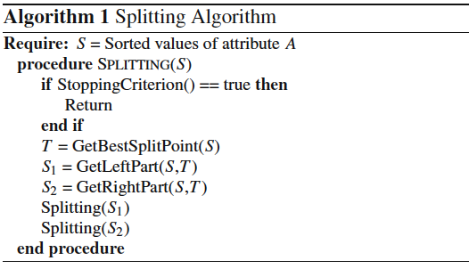
Description of Representative Methods
Splitting

Slide 52
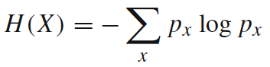
Description of Representative Methods
Splitting
MDLP — This discretizer uses the entropy measure to evaluate candidate cut points. Entropy is one of the most commonly used discretization measures in the literature. The entropy of a sample variable X is
where x represents a value of X and p_{x} its estimated probability of occurring.

Slide 53
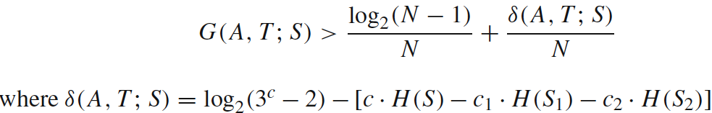
Description of Representative Methods
Splitting
MDLP — Information is high for lower probable events and low otherwise. This discretizer uses the Information Gain of a cut point, which is defined as
where A is the attribute in question, T is a candidate cut point and S is the set of N examples. So, S_{i} is a partitioned subset of examples produced by T. The MDLP discretizer applies the Minimum Description Length Principle to decide the acceptation or rejection for each cut point and to govern the stopping criterion.

Slide 54
Ilustrasi efek diskretisasi terhadap kualitas model prediktif
Akan dipaparkan situasi dimana diskretisasi mampu memberikan peningkatan akurasi prediksi pada model regresi logistik
Akan dibandingkan akurasi dua model dengan data yang sama
Model pertama menggunakan variabel prediktor asli
Model kedua menggunakan variabel prediktor yang telah didiskretkan
Buka file program “UNP diskretisasi.R”

Slide 55
> table(data.ts$class, prediksi.mdlp)
prediksi.mdlp
0 1
0 177 50
1 73 158
> mean(data.ts$class == prediksi.mdlp)
[1] 0.731441
Catatan: akurasi dari model tanpa
diskretisasi adalah 0.5021834

Slide 56
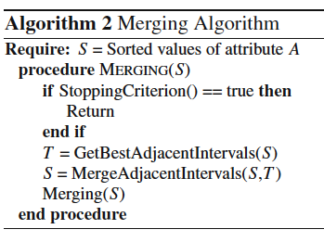
Description of Representative Methods
Merging

Slide 57
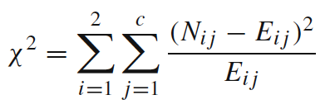
Description of Representative Methods
Merging
ChiMerge — χ² is a statistical measure that conducts a significance test on the relationship between the values of an attribute and the class. This statistic determines the similarity of adjacent intervals based on some significance level. Actually, it tests the hypothesis that two adjacent intervals of an attribute are independent of the class. χ² is computed as:

Slide 58
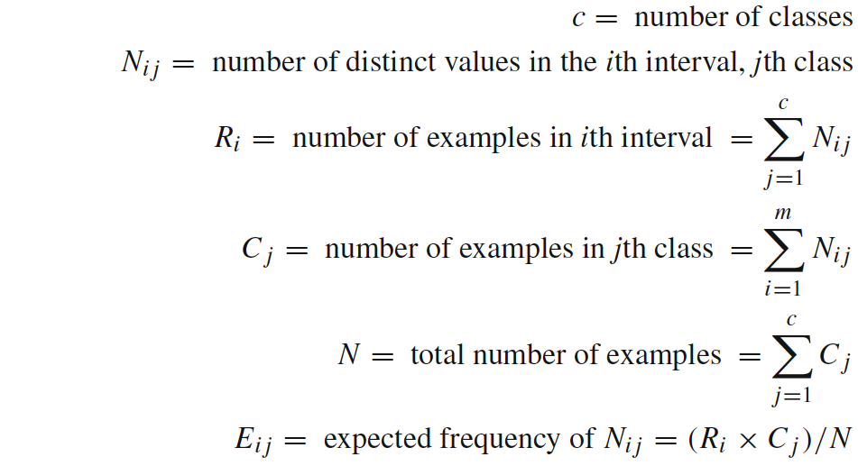
Description of Representative Methods
Merging
ChiMerge —
It is a supervised, bottom-up discretizer. At the beginning, each distinct value of the attribute is considered to be one interval. χ² tests are performed for every pair of adjacent intervals. Those adjacent intervals with the least χ² value are merged until the chosen stopping criterion is satisfied.

Slide 59
Ilustrasi efek diskretisasi terhadap kualitas model prediktif
Akan dipaparkan situasi dimana diskretisasi mampu memberikan peningkatan akurasi prediksi pada model regresi logistik
Akan dibandingkan akurasi dua model dengan data yang sama
Model pertama menggunakan variabel prediktor asli
Model kedua menggunakan variabel prediktor yang telah didiskretkan
Buka file program “UNP diskretisasi.R”

Slide 60
> table(data.ts$class, prediksi.chim)
prediksi.chim
0 1
0 189 38
1 77 154
> mean(data.ts$class == prediksi.chim)
[1] 0.7489083
Catatan: akurasi dari model tanpa
diskretisasi adalah 0.5021834

Slide 61
Weight of Evidence
dan
information value
Bagus Sartono
Departemen Statistika
Fakultas Matematika dan Ilmu Pengetahuan Alam

Slide 62
Introduction
These two concepts - weight of evidence (WOE) and information value (IV) evolved from the logistic regression technique.
These two terms have been in existence in credit scoring world for more than 4-5 decades.
They have been used as a benchmark to screen variables in the credit risk modeling projects such as probability of default.
They help to explore data and screen variables.
It is also used in marketing analytics project such as customer attrition model, campaign response model etc.

Slide 63
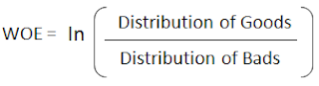
What is Weight of Evidence (WOE)?
The weight of evidence tells the predictive power of an independent variable in relation to the dependent variable.
Since it evolved from credit scoring world, it is generally described as a measure of the separation of good and bad customers.
"Bad Customers" refers to the customers who defaulted on a loan. and "Good Customers" refers to the customers who paid back loan.

Slide 64
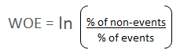
Many people do not understand the terms goods/bads as they are from different background than the credit risk.
It's good to understand the concept of WOE in terms of events and non-events.
It is calculated by taking the natural logarithm (log to base e) of division of % of non-events and % of events.

Slide 65
Steps of Calculating WOE
For a continuous variable, split data into 10 parts (or lesser depending on the distribution).
Calculate the number of events and non-events in each group (bin)
Calculate the % of events and % of non-events in each group.
Calculate WOE by taking natural log of division of % of non-events and % of events
Note : For a categorical variable, you do not need to split the data (ignore Step 1 and follow the remaining steps)

Slide 66
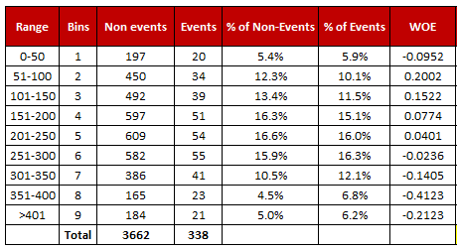
Steps of Calculating WOE

Slide 67
Rules related to WOE
Each category (bin) should have at least 5% of the observations.
Each category (bin) should be non-zero for both non-events and events.
The WOE should be distinct for each category. Similar groups should be aggregated.
Missing values are binned separately.

Slide 68
Number of Bins (Groups)
In general, 10 or 20 bins are taken.
Ideally, each bin should contain at least 5% cases.
The number of bins determines the amount of smoothing - the fewer bins, the more smoothing.
If someone asks you ' "why not to form 1000 bins?" The answer is the fewer bins capture important patterns in the data, while leaving out noise.
Bins with less than 5% cases might not be a true picture of the data distribution and might lead to model instability.

Slide 69
Handle Zero Event/ Non-Event
If a particular bin contains no event or non-event, you can use the formula below to ignore missing WOE. We are adding 0.5 to the number of events and non-events in a group. AdjustedWOE = ln (((Number of non-events in a group + 0.5) / Number of non-events)) / ((Number of events in a group + 0.5) / Number of events))

Slide 70
Benefits of WOE
It can treat outliers. Suppose you have a continuous variable such as annual salary and extreme values are more than 500 million dollars. These values would be grouped to a class of (let's say 250-500 million dollars). Later, instead of using the raw values, we would be using WOE scores of each classes.
It can handle missing values as missing values can be binned separately.
Since WOE Transformation handles categorical variable so there is no need for dummy variables.
WoE transformation helps you to build strict linear relationship with log odds. Otherwise it is not easy to accomplish linear relationship using other transformation methods such as log, square-root etc. In short, if you would not use WOE transformation, you may have to try out several transformation methods to achieve this.

Slide 71
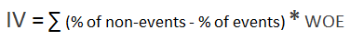
What is Information Value (IV)?
Information value is one of the most useful technique to select important variables in a predictive model. It helps to rank variables on the basis of their importance. The IV is calculated using the following formula :

Slide 72
Rules related to Information Value
Information Value | Variable Predictiveness
Less than 0.02 | Not useful for prediction
0.02 to 0.1 | Weak predictive Power
0.1 to 0.3 | Medium predictive Power
0.3 to 0.5 | Strong predictive Power
>0.5 | Suspicious Predictive Power (check once)

Slide 73
Hands-On
Buka file “UNP information value.R”

Slide 74
Pohon Klasifikasi
dan
ensemble tree
Bagus Sartono
Departemen Statistika
Fakultas Matematika dan Ilmu Pengetahuan Alam

Slide 75
Outline
Pengenalan Konsep Entropy dan Information Gain
Pengenalan Algoritma Dasar Pohon Klasifikasi
Pengembangan Lebih Lanjut dari Pohon Klasifikasi

Slide 76
Nama Lain
Classification Tree
Decision Tree
Recursive Partition
Iterative Dichotomiser

Slide 77
Kegunaan
Mengidentifikasi variabel apa yang dapat dijadikan sebagai pembeda antar kelompok
Memprediksi keanggotaan kelompok suatu individu berdasarkan karakteristiknya
Terapannya antara lain:
Marketing: Mengidentifikasi prospective customer (cross-sell, up-sell, new acquisition)
Risk: Credit scoring, menentukan apakah calon penerima kredit akan mampu bayar atau tidak
Customer Relationship: churn analysis, menentukan customer yang berpotensi akan meninggalkan jasa/produk
Health: menentukan tingkat resiko penyakit
dll

Slide 78
Metode Lain yang Setara Kegunaannya
Regresi Logistik
Discriminant Analysis
Support Vector Machine
Bayesian Classifier
Neural Network
dll

Slide 79
Ilustrasi penggunaan pohon klasifikasi
Rumah Milik Sendiri
Tidak
Ya
Jenis Kelamin
Penghasilan Per Bulan
Laki-Laki
Perempuan
> 10
≤ 10
Good
Bad
Good
Status Pernikahan
Single
Divorced, Married
Good
Bad

Slide 80


Profil:
Pria
Rumah Sendiri
Penghasilan 8 juta per bulan
Bujangan
Rumah Milik Sendiri
Tidak
Ya
Jenis Kelamin
Penghasilan Per Bulan
?
Laki-Laki
Perempuan
> 10
≤ 10
Good
Bad
Good
Status Pernikahan
Single
Divorced, Married
Good
Bad

Slide 81
Profil:
Pria
Rumah Sendiri
Penghasilan 8 juta per bulan
Bujangan
Rumah Milik Sendiri
Tidak
Ya
Jenis Kelamin
Penghasilan Per Bulan
?
Laki-Laki
Perempuan
> 10
≤ 10
Good
Bad
Good
Status Pernikahan
Single
Divorced, Married
Good
Bad

Slide 82
Profil:
Pria
Rumah Sendiri
Penghasilan 8 juta per bulan
Bujangan
Rumah Milik Sendiri
Tidak
Ya
Jenis Kelamin
Penghasilan Per Bulan
?
Laki-Laki
Perempuan
> 10
≤ 10
Good
Bad
Good
Status Pernikahan
Single
Divorced, Married
Good
Bad

Slide 83
Profil:
Pria
Rumah Sendiri
Penghasilan 8 juta per bulan
Bujangan
Rumah Milik Sendiri
Tidak
Ya
Jenis Kelamin
Penghasilan Per Bulan
?
Laki-Laki
Perempuan
> 10
≤ 10
Good
Bad
Good
Status Pernikahan
Single
Divorced, Married
Good
Bad

Slide 84
Profil:
Pria
Rumah Sendiri
Penghasilan 8 juta per bulan
Bujangan
Rumah Milik Sendiri
Tidak
Ya
Jenis Kelamin
Penghasilan Per Bulan
Laki-Laki
Perempuan
> 10
≤ 10
Good
Bad
Good
Status Pernikahan
Single
Divorced, Married
Good
Bad

Slide 85
1
Entropy dan Information Gain

Slide 86
Entropy dan Information Gain
Andaikan sebuah gugus data D berisi individu-individu dengan dua kelas yaitu kelas YES dan NO, dengan proporsi yang YES sebesar p, dan tentusaja (1 – p) lainnya tergolong kelas NO.
Entropi dari gugus data tersebut adalah
E(D) = –p log₂(p) – (1–p) log₂(1–p)
Gugus data yang seluruh amatannya dari kelas YES akan memiliki E(D) = 0
Gugus data yang seluruh amatannya dari kelas NO juga akan memiliki E(D) = 0
Entropi ini adalah ukuran kehomogenan data (impurity)

Slide 87
Entropy dan Information Gain
Very impure group
Less impure
Minimum impurity

Slide 88
Entropy dan Information Gain
Andaikan sebuah gugus data D dibagi menjadi beberapa kelompok, misalnya D₁, D₂, …, D_{k} berdasarkan variabel prediktor V
Dari setiap D_{i} bisa dihitung entropinya, yaitu E(D_{i})
Information Gain adalah
Variabel prediktor yang kuat hubungannya akan memiliki information gain yang semakin besar

Slide 89
2
Algoritma Pohon Klasifikasi

Slide 90
Ide Dasar
B
4
16 obs
13 obs
3
Mencari pemisah terbaik antara individu dengan individu
2
1
A
Pemisahan dilakukan untuk masing-masing variabel, bukan kombinasinya.
1
2
3
4

Slide 91
Ide Dasar
B
4
16 obs
13 obs
3
Pemisah yang dicari adalah yang menyebabkan data hasil pemisahannya bersifat homogen kelasnya.
2
1
A
1
2
3
4

Slide 92
Ide Dasar
B
A < 2
A ≥ 2
Pemisahan menggunakan garis A = 2, menghasilkan dua kelompok:
Kelompok 1 A < 2
Kelompok 2 A ≥ 2
4
3
7 obs
2
12 obs
1
9 obs
A
1 obs
1
2
3
4
16 obs
13 obs

Slide 93
Ide Dasar
B
A < 2.7
A ≥ 2.7
Pemisahan menggunakan garis A = 2.7, menghasilkan dua kelompok:
Kelompok 1 A < 2.7
Kelompok 2 A ≥ 2.7
4
3
11 obs
2
13 obs
1
5 obs
A
0 obs
1
2
3
4
16 obs
13 obs

Slide 94
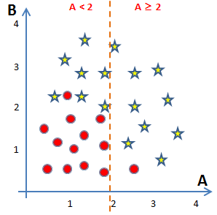
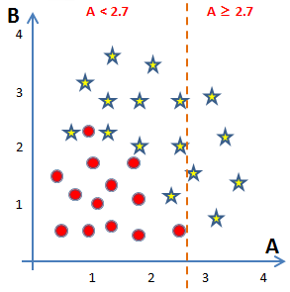
Ide Dasar
16 obs
13 obs
7 obs
9 obs
11 obs
5 obs
12 obs
1 obs
13 obs
0 obs
Mana yang lebih baik?

Slide 95
Ide Dasar
16 obs
13 obs
Entropy = 0.9923
7 obs
9 obs
11 obs
5 obs
12 obs
1 obs
13 obs
0 obs
E = 0.9495
E = 0.4690
E = 0.9950
E = 0

Information Gain = 0.2085
Information Gain = 0.1688

Slide 96
Ide Dasar
◆
A = 2
B
4
3
Lanjutkan mencari pemisahan untuk masing-masing kelompok….
2
1
A
1
2
3
4

Slide 97
Ide Dasar
◆
A = 2
B
4
3
Lanjutkan mencari pemisahan untuk masing-masing kelompok….
❖
B = 1.9
2
1
⬥
B = 0.6
A
1
2
3
4

Slide 98
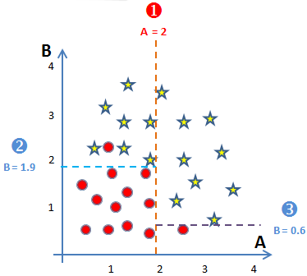
Representasi Hasil Pemisahan
16 obs
13 obs
A < 2
7 obs
9 obs
12 obs
1 obs
B < 1.9
B < 0.6
0 obs
7 obs
0 obs
9 obs
11 obs
1 obs
1 obs
0 obs

Slide 99
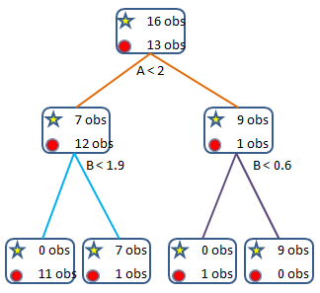
Beberapa Istilah
root
(simpul akar)
Level 0
node
(simpul)
Level 1
depth
leaf
(simpul akhir)
Level 2

Slide 100
Kriteria Penghentian Proses Pemisahan
Simpul berisi amatan yang berasal dari satu kelas variabel respon
Simpul berisi amatan yang seluruh variabel prediktornya identik
Simpul berisi amatan yang kurang dari ukuran simpul minimal yang ditentukan di awal
Kedalaman pohon sudah mencapai kedalaman maksimal

Slide 101
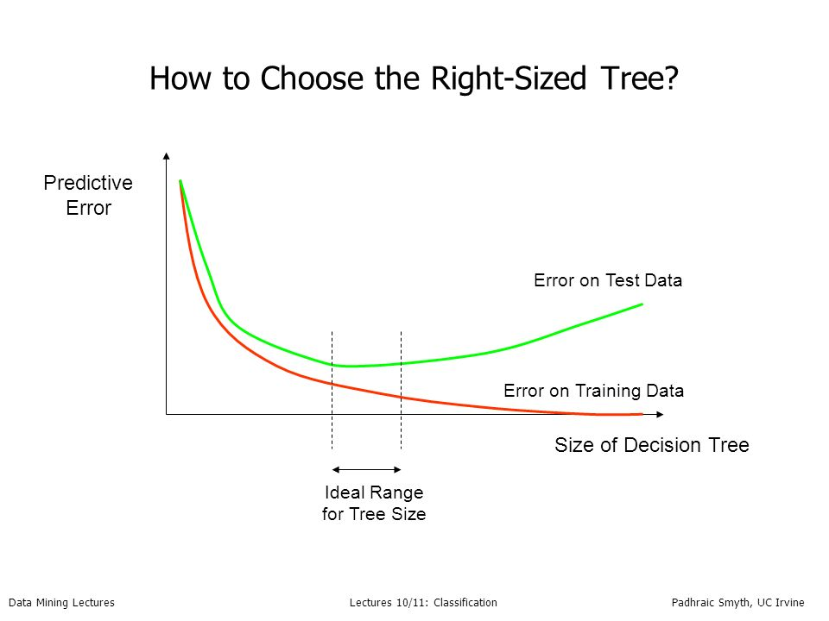

Slide 102
3
Ensemble Tree

Slide 103
Rationale
There is no algorithm that is always the most accurate
Generate a group of base-learners which when combined has higher accuracy
Each algorithm makes assumptions which might be or not be valid for the problem at hand.
Different learners use different
Algorithms
Hyperparameters
Representations (Modalities)
Training sets
Subproblems

Slide 104
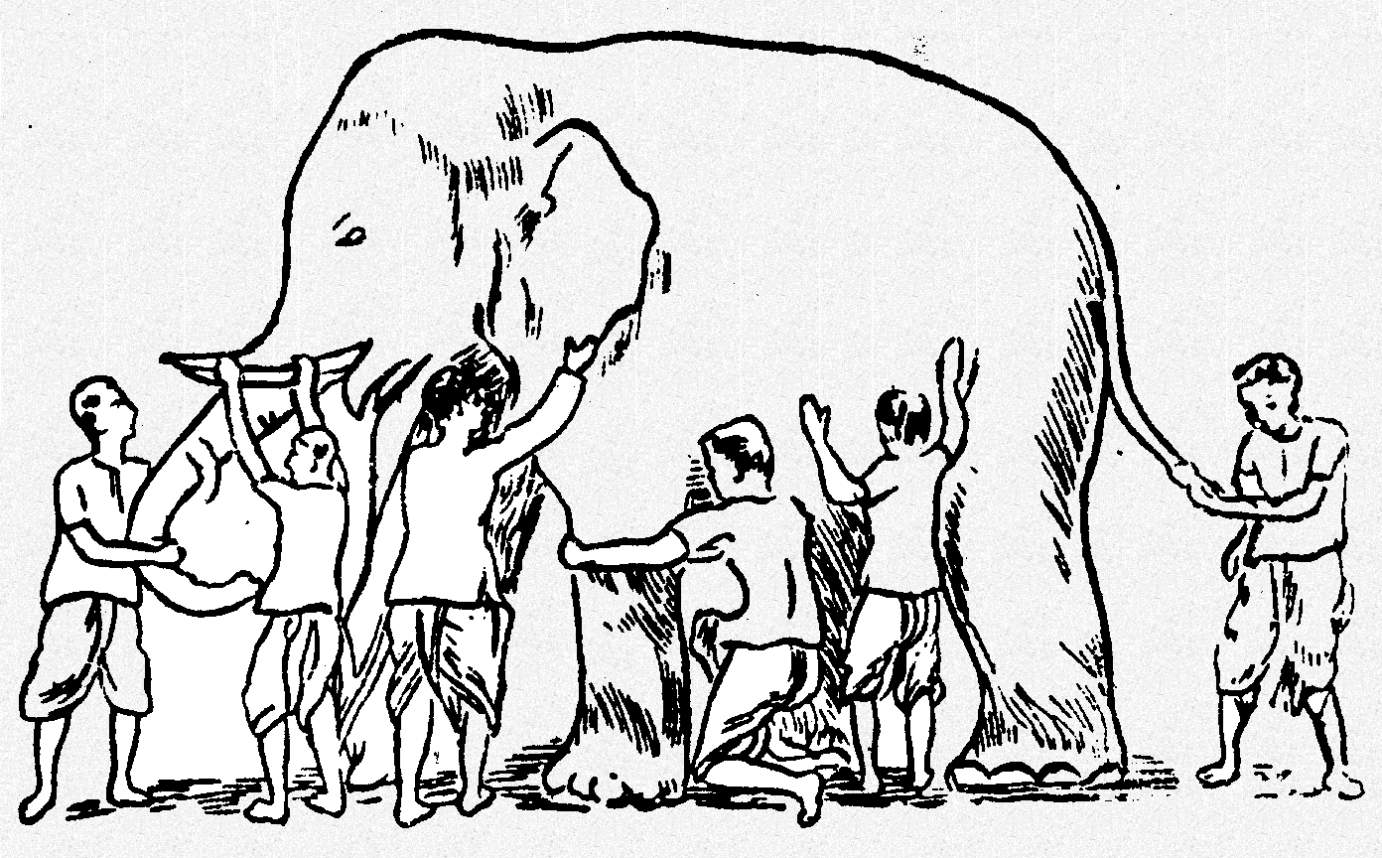
Why Ensemble Works?
Some unknown distribution
Model 1
Model 3
Model 6
Model 5
Model 2
Model 4
Ensemble gives the global picture!

Slide 105
Why does it work?
Suppose there are 25 base classifiers
Each classifier has error rate, ε = 0.35
Assume classifiers are independent
Probability that the ensemble classifier makes a wrong prediction:

Slide 106
What is the Main Challenge for Developing Ensemble Models?
The main challenge is not to obtain highly accurate base models, but rather to obtain base models which make different kinds of errors.
High accuracies can be accomplished if different base models misclassify different training examples, even if the base classifier accuracy is low.

Slide 107
General Idea

Slide 108
Bagging
Bagging stands for Bootstrap Aggregation
Use bootstrapping to generate L training sets and train one base-learner with each
Use voting (Average or median with regression)
Unstable algorithms profit from bagging

Slide 109
Bagging
Training Data
M features
N examples
Notes:
As the classifier of choice we adopt Random Forest Classifier, due to its robustness to heterogenous and noisy feature.
Random Forest is an ensembe classifier. Briefly, given N data and M features, bootsrap samples are created from the traning data

Slide 110
Bagging
Create bootstrap samples
from the training data
M features
N examples
....…

Slide 111
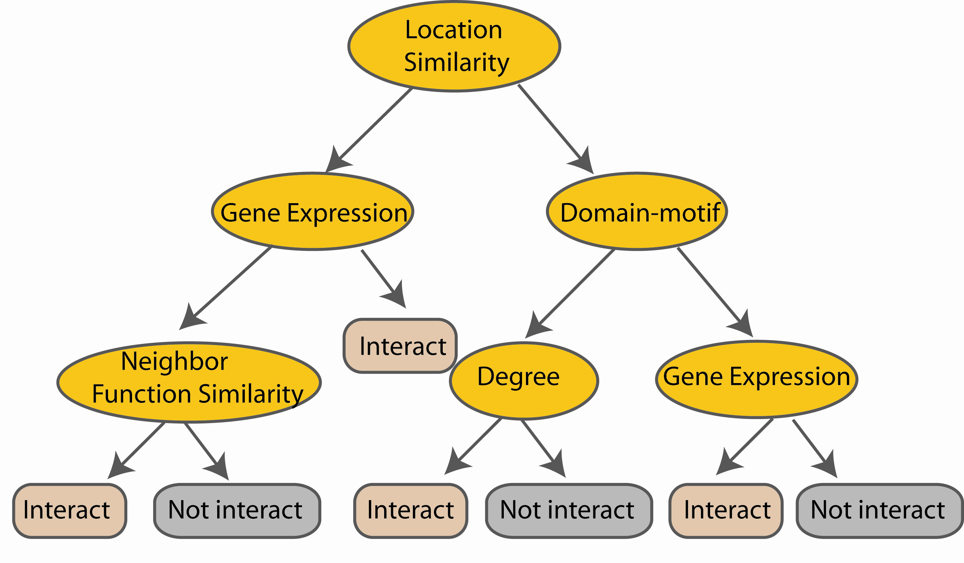
Bagging
Construct a decision tree
M features
N examples
....…
Notes:
From eachd descision tree .. In spliting the nodes, the Gini Gain is employed

Slide 112

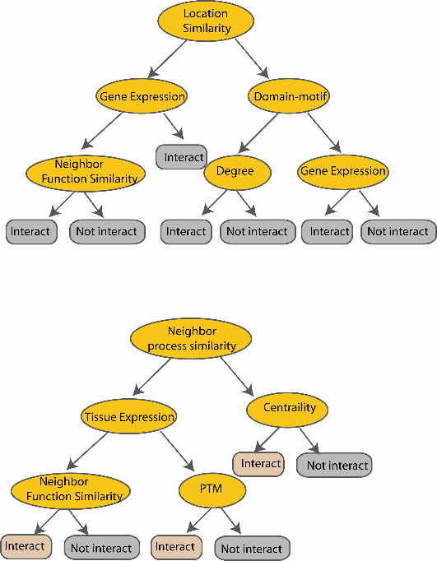
Bagging
Create decision tree
from each bootstrap sample
M features
N examples
....…
....…

Slide 113
Bagging
Create decision tree
from each bootstrap sample
M features
N examples
Take he majority vote
....…
....…

Slide 114
Random Forest

Slide 115
Definition
Random forest merupakan salah satu bentuk teknik klasifikasi ensemble yang tersusun atas banyak pohon klasifikasi dan kelas prediksi merupakan modus (suara terbanyak) dari kelas prediksi yang dihasilkan oleh masing-masing pohon
Istilah ini berasal dari random decision forests yang diusulkan pertama kali oleh Tin Kam Ho dari Bell Labs pada tahun 1995.
Metode ini merupakan gabungan dari ide Breiman tentang bagging dan seleksi variabel secara acak.

Slide 116
Review tentang Classification Tree atau Decision Trees
Pohon klasifikasi merupakan teknik klasifikasi tunggal yang digabungkan dalam metode random forest.
Salah satu algoritma yang banyak digunakan adalah CART… classification and regression tree.
CART … greedy, top-down binary, recursive partitioning, membagi-bagi ruang data menjadi gugus-gugus saling lepas berbentuk rectangular
Gugus-gugus tersebut dibentuk sedemikian rupa sehingga bersifat homogen kelas variabel responnya
Prediksi didasarkan pada kelas terbanyak pada simpul akhir

Slide 117
Algoritma umum Random Forest
Setiap pohon dibentuk dengan menggunakan prosedur berikut:
Andaikan banyaknya observasi pada data training adalah N dan banyaknya variabel prediktor adalah M.
Tentukan besaran m < M, yaitu banyaknya variabel yang dievaluasi dalam setiap pembentukan sekatan (split) pada pembuatan pohon
Lakukan pengambilan sampel secara bootstrap (sampling with replacement) sebanyak n dari N buah observasi. Observasi sisanya yang tidak terpilih akan digunakan untuk menduga tingkat kesalahan.
Untuk setiap simpul, pilih secara acak m variabel untuk digunakan menentukan sekatan terbaik.
Setiap pohon dibentuk tanpa ada proses pemangkasan.
Prediksi terhadap amatan baru dilakukan pada setiap pohon. Selanjutnya proses majority vote dilakukan untuk menghasilkan prediksi dari random forest.

Slide 118
Random Forest – practical consideration
Berapa banyak pohon?
Berapa banyak variabel yang dipilih secara acak?

Slide 119
Random Forest Classifier
Training Data
M features
N examples
Notes:
As the classifier of choice we adopt Random Forest Classifier, due to its robustness to heterogenous and noisy feature.
Random Forest is an ensembe classifier. Briefly, given N data and M features, bootsrap samples are created from the traning data

Slide 120
Random Forest Classifier
Create bootstrap samples
from the training data
M features
N examples
....…

Slide 121
Random Forest Classifier
Construct a decision tree
M features
N examples
....…
Notes:
From eachd descision tree .. In spliting the nodes, the Gini Gain is employed

Slide 122

Random Forest Classifier
At each node in choosing the split feature
choose only among m<M features
M features
N examples
....…
Notes:
Different from the regular decision trees in random forest, when the splitting feature is chosen from only a subset of allf eatures.
The robostness of the classifier arises from
bootsraping of the training data and the random selection of features, the the random choose of features.

Slide 123
Random Forest Classifier
Create decision tree
from each bootstrap sample
M features
N examples
....…
....…

Slide 124
Random Forest Classifier
Create decision tree
from each bootstrap sample
M features
N examples
Take he majority vote
....…
....…

Slide 125
Outline
#01
Tantangan dalam Pembelajaran
#02
Kompetensi yang Diperlukan Statistikawan
#03
Saran terhadap Pengembangan Kurikulum Statistika

Slide 126
Bagian #01
Tantangan dalam Pembelajaran
Statistika dan Analitika

Slide 127
semua orang sudah aware pentingnya data

Slide 128
Yang diperlukan tidak hanya melek data (data literate), tapi kemampuan belajar dari data (learning from data)

Slide 129
… bahkan dalam bentuk beraneka rupa
data bertambah dengan sangat cepat

Slide 130
penekanan tidak lagi pada research, namun lebih ke arah discovery
Data tidak dirancang untuk analisis tertentu
Lebih banyak bersifat eksploratif, ketimbang konfirmatif
Model driven → data driven → purpose driven

Slide 131
target kurikulum adalah orang yang kenal gadget sejak kecil
… malah ada yang nyebut dengan istilah multi-screen generation

Slide 132
mahasiswa memiliki banyak pilihan sumber pengetahuan…
penjelasan dosen di kelas bisa jadi kurang menarik bagi mahasiswa dibandingkan tutorial di youtube

Slide 133
… ketika permasalahan menjadi lebih kompleks dan butuh lintas keilmuan untuk menyelesaikannya
kolaboratif menjadi sangat penting

Slide 134
Bagian #02
Kompetensi yang Diperlukan Statistikawan

Slide 135
Kompetensi Terkait Data
#1
Akuisisi Data (Data Acquisition)
#6
#2
Kontekstualisasi Hasil Analitik (Analytic Contextualizing)
Pengelolaan Data (Data Management)
#5
Komunikasi dan Visualisasi Data (Communication and Visualization)
#3
#4
Eksplorasi Data
(Data Exploratory)
Pemodelan Prediktif (Predictive Modeling)

Slide 136
skill lain yang diperlukan menurut World Economic Forum menyongsong jaman AI dan Robotik
Complex problem solving
Critical thinking
Creativity
People management
Coordinating with others
Emotional intelligence
Judgment and decision making
Service orientation
Negotiation
Cognitive Flexibility

Slide 137
Bagian #03
Saran terhadap Kurikulum

Slide 138
Secara umum, kurikulum statistika saat ini masih relevan, namun memerlukan beberapa adaptasi konten dan the way of delivery
Beberapa saran

Slide 139
Saran #01
Tingkatkan keterpaparan mahasiswa dengan kasus nyata… termasuk di kelas. Jangan hanya menggunakan ilustrasi rekaan, apalagi yang kurang masuk akal.
Tentu saja mulai dengan ilustrasi yang “dekat” dengan kehidupan mereka
Datangkan praktisi ke kampus

Slide 140
Saran #02
Berikan pengalaman kepada mahasiswa berhadapan dengan data mentah beraneka rupa dan ukuran yang besar.
Jangan manjakan mahasiswa dengan data yang sudah siap olah.

Slide 141
Saran #03
Perkaya dan perkuat keterampilan komputasi, algoritma, dan pemrograman
Kenalkan coding sejak dini, terutama dalam bahasa yang sedang nge-hits

Slide 142
Saran #04
visualization, visualization, visualization

Slide 143
Perbesar kemungkinan mahasiswa untuk mengambil mata kuliah dari prodi atau departemen lain…
Saran #05

Slide 144
Saran #06
Berikan mahasiswa banyak kesempatan untuk presentasi… Berikan pula feedback untuk perbaikan.
Bekali mahasiswa dengan kemampuan menyusun dan melakukan narrative story telling

Slide 145
Saran #07
Magang/Project memberikan kesempatan bekerja-sama dengan orang dari bidang lain.

Slide 146
Saran #08
Asah kemampuan self-learning mahasiswa
Dosen lebih memegang peran sebagai fasilitator
Dosen harus ter-update dengan baik

